Slide 1
From Intensity Frontier to Energy Frontier
Stuart Henderson
Associate Laboratory Director for Accelerators
Advanced Accelerator Concepts Workshop
June 11, 2012
Notes:
The last 10 years or so have been a remarkably productive, exciting and satisfying period in the field of high-power proton accelerators. We have seen the construction, commissioning and initial operation of two billion dollar-class, MW-class proton accelerator facilities: the SNS at Oak Ridge, and J-PARC in Japan. Those accelerators built upon the experience at facilities that have now been in operation for two to three decades. As we think about and design tomorrow’s multi-MW accelerators it is natural to ask what we’ve learned from these present-generation MW-class facilities. That is the subject of this talk.
need to incorporate the experience of these present-generation proton accelerators. I’d like to describe the experience of these recently commissioned facilities and explore the prospects for taking the next step in proton beam power.

Slide 2

From the Chairman: “You’re mission should you choose to accept it…”
“…provide a perspective on how future Intensity Frontier accelerators could evolve into the next generation Energy Frontier accelerators, and to connect the associated R&D needs to the Advanced Accelerator Concepts Workshop community.”

Slide 3
Why This Talk, at this Workshop, and Why Me?
The nation’s particle physics program is shifting directions
Fermilab is the nation’s particle physics laboratory
I am responsible for ensuring that Fermilab has a handle on technology needed to build the next generation facilities for particle physics, and that we’re doing the necessary long-range R&D to support the machines of the far future.
I spent a lot of time working to support and make the case for accelerator R&D, and for this field in particular, because I truly believe that this field plants the seeds that grow into tomorrow’s accelerators
I am a booster but more importantly, a customer!

Slide 4

Particle Physics (from an Accelerator Physicist Perspective)

Slide 5
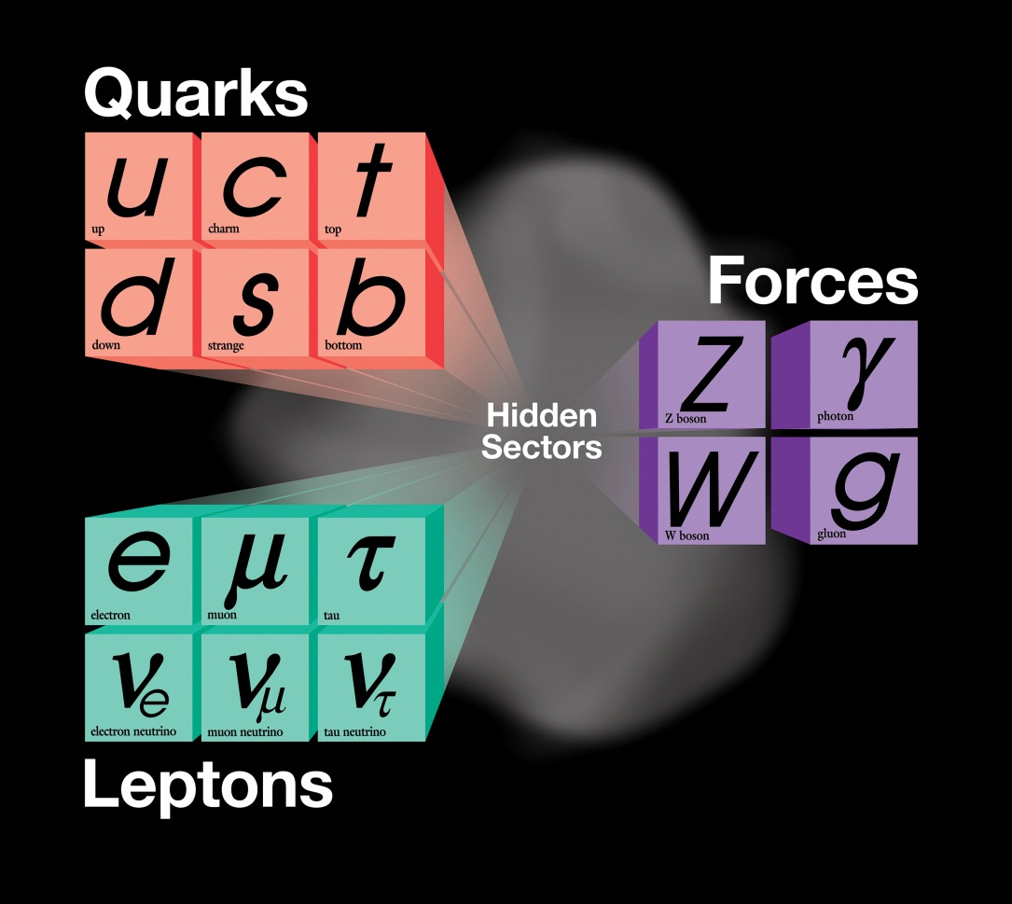
The State of Knowledge
The present theory is a remarkable intellectual construction
Every particle experiment ever done fits in the framework
But it is not complete; basic symmetries of the Lagrangian require symmetry breaking

Slide 6
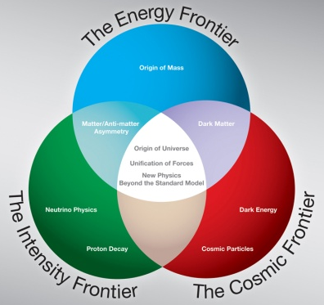
Frontiers of Particle Physics (or, how we explain what we do to Congress)

Slide 7
The Big Questions in Particle Physics
The sense of mystery has never been greater. With increased knowledge our ignorance becomes more acute:
  Why is matter dominant?
  Where does mass come from?
  What are the neutrino masses and what do they say?
  Where are the heavy neutrino partners?
  Why only three families of quarks and leptons?
  Do the forces unify?
  Does nature use supersymmetry or other new symmetries?
  Are there extra dimensions of space?
  What is dark matter?
  What is dark energy?

Slide 8
Frontiers of Particle Physics
Do the forces unify?
Does nature use supersymmetry or other new symmetries?
Are there extra dimensions of space?
  Where does mass come from?
Why is matter dominant?
What are the neutrino masses and what do they say?
Where are the heavy neutrino partners?
Why only three families of quarks and lepton?
What is dark matter?
What is dark energy?

Slide 9
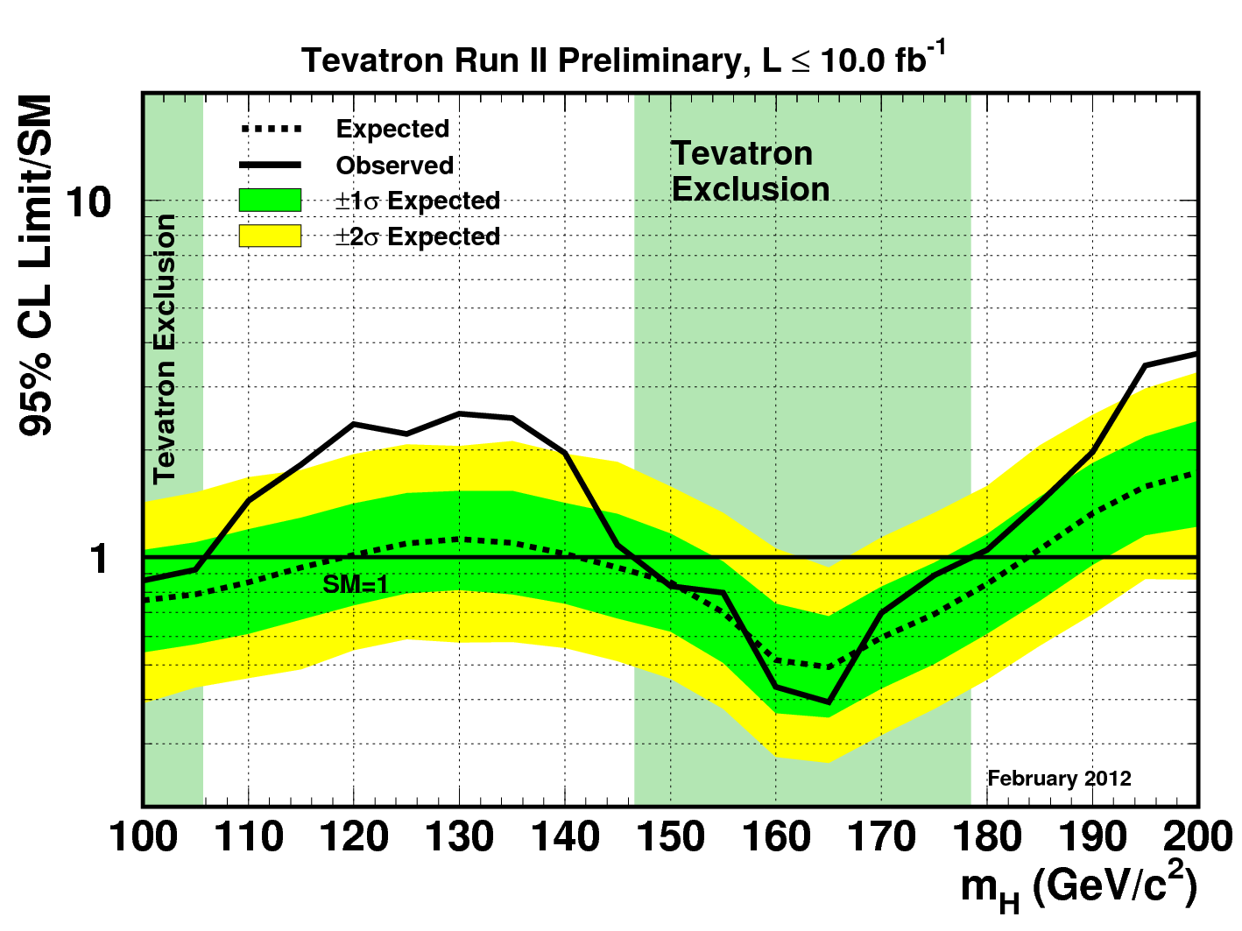
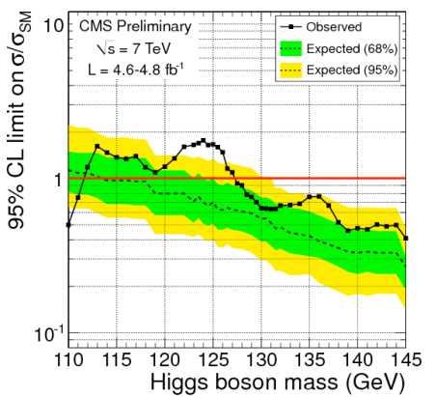
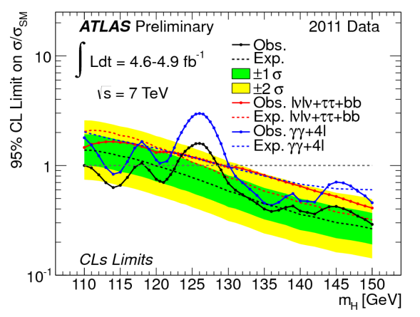
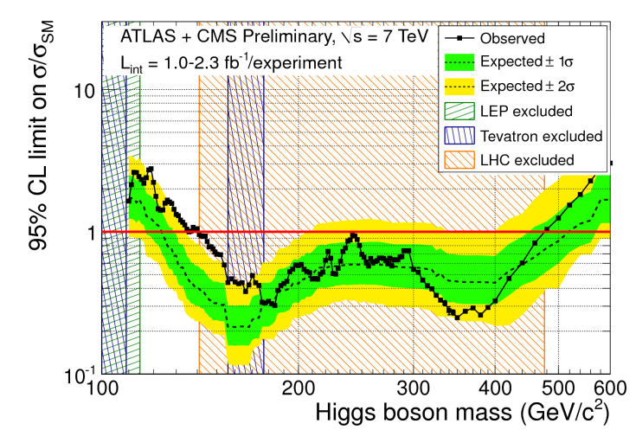
Recent Higgs Results: LHC and Tevatron see hints for the Higgs…is it there?
Excluded by direct searches at 95%CL
LEP
LHC
Tevatron
Higgs Mass [GeV/c²]
Consistent with expectation from precision measurements

Slide 10
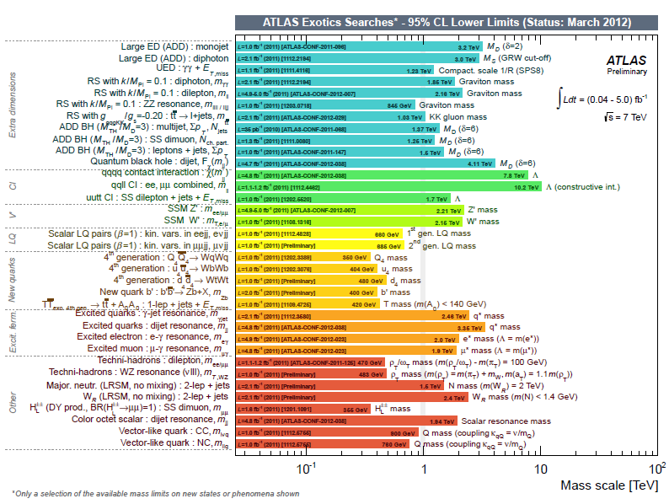
What about Supersymmetry?

Slide 11
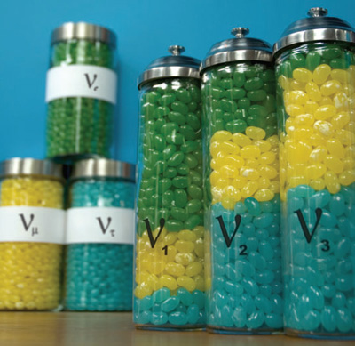
What About Neutrinos?
We now know that Neutrinos
  have small, but non-zero mass,
  “mix” with one another
  oscillate among “flavor” states
A quote attributed to Weinberg sums up the situation:
  the discovery of neutrino mass is the most important discovery in elementary particle physics in the last quarter century. It is the first phenomenon to be seen in laboratory experiments that cannot be understood within the original Standard Model
Long-baseline neutrino experiments aim to answer the questions:
  What are the relative masses of the three known neutrinos?
  How strong is the mixing?
  Do neutrinos violate CP symmetry?
  Is mixing related to the matter-antimatter asymmetry in the universe?

Slide 12
Neutrinos: What are they telling us?
Andre de Gouvea, Northwestern University

Slide 13
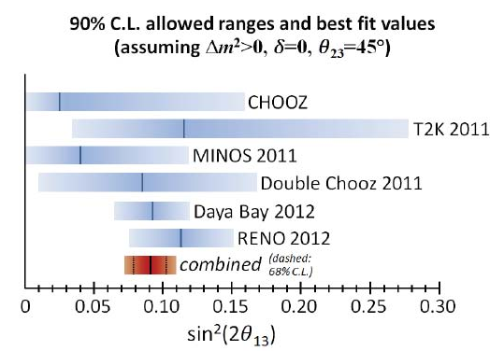
Recently: sin²2θ₁₃ measured (March 2012)
θ₁₃ needs to be non-zero in order to have a CP-violating phase, δ
If measurements determine that δ has a value such that, P(ν_{μ}→ν_{τ}) ≠ P(ν_{μ}→ν_{τ}) says that neutrinos violate CP, which may be connected to CP violation in the early universe, and hence to the observed matter-anti-matter asymmetry
_
_
Ryan Patterson

Slide 14

Where is Accelerator-Based HEP Going?

Slide 15
Where is Accelerator-Based HEP Going?
LHC will make a statement on the Higgs, and potentially supersymmetry or other beyond-standard-model physics
We eagerly await LHC results! LHC results will ultimately provide guidance for the Energy Frontier
  Perhaps a Higgs factory will be required to fully unravel
  Perhaps BSM results will motivate a multi-TeV lepton collider
But looking further out, it’s difficult to probe well beyond LHC energies
Two approaches to probe mass-scales well beyond LHC:
  Very intense beams to search for high-mass scales in rare decays/precision measurements
  Very high energies, well beyond what we discuss routinely, enabled by advanced concepts, such as acceleration in crystal-channels, solid-state plasmas driven by high brightness x-rays

Slide 16
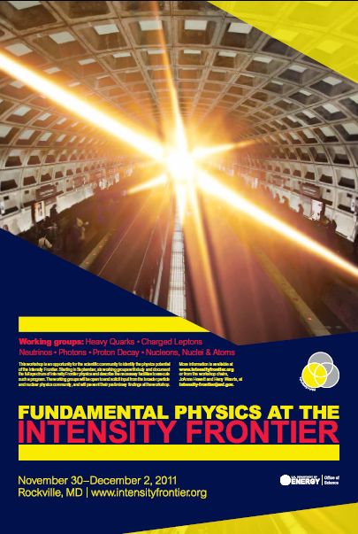
Intensity Frontier of Particle Physics
It is well-appreciated that the physics of the Intensity Frontier plays a central role in particle physics, and that a healthy field requires the complementarity of Energy and Intensity Frontier facilities
It is also appreciated that rare processes probe mass scales well beyond the LHC
A recent very successful Workshop assessed the scientific opportunities in intensity frontier physics
MW-class accelerators can power a program that will help to unravel the mysteries of the neutrino sector and probe rare processes with greatly improved sensitivity
Fermilab (and the nation’s) strategy is to develop the facilities to enable a world-leading program in Intensity Frontier Physics

Slide 17

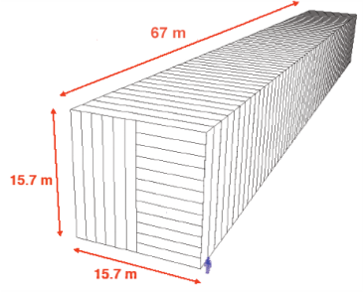
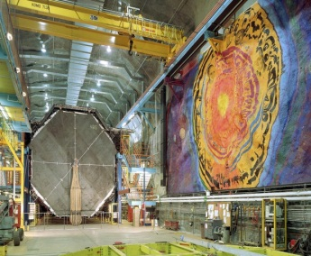
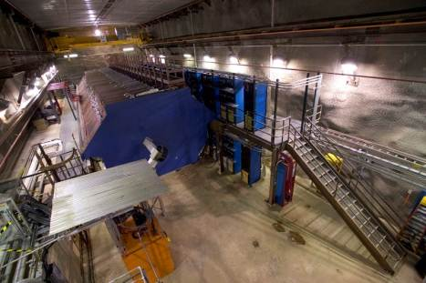
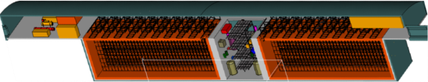
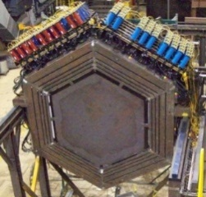

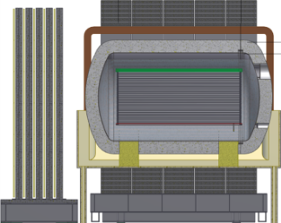
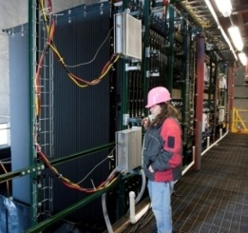
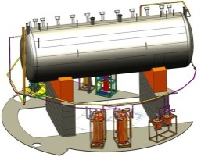
Intensity Frontier: Neutrino Sector
under construction
Online 2013
(700 kW)
NOvA (far)
MINOS (far)
Operating
since 2005
(350 kW)
MINOS (near)
735 km
810 km
MINERvA
LBNE under development
1300 km
Far detector
(34 kton LAr TPC)
MiniBooNE
NOvA
(near)
Near detector
MicroBooNE
under construction
(LAr TPC)

Slide 18
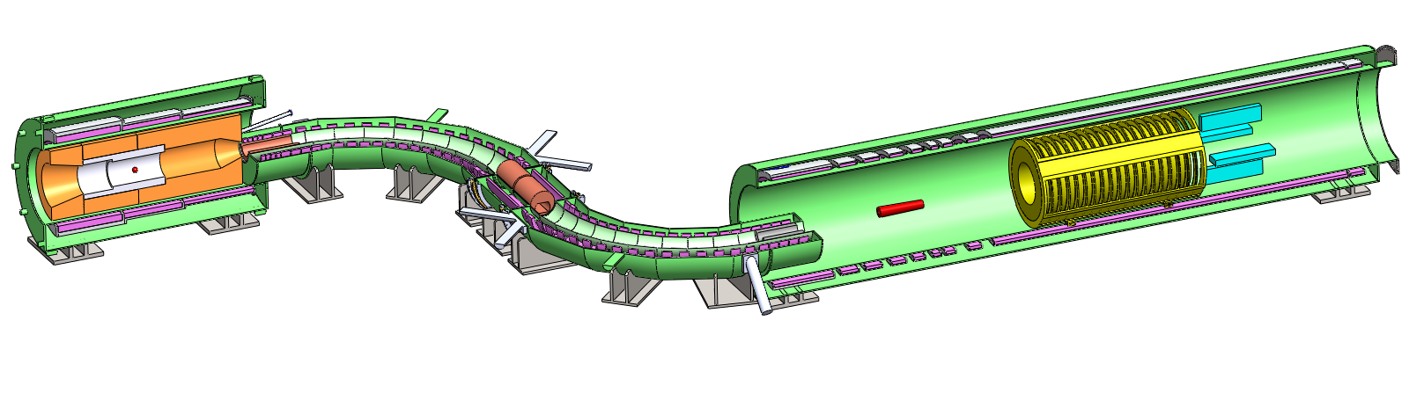
Intensity Frontier: Precision and Rare Processes
Mu2e
Production Solenoid
Detector Solenoid
Search for Muon to electron conversion in the field of a nucleus
Transport Solenoid
New Physics
Scale (TeV)
Calorimeter
Proton Beam
to Target
Stopping Target
μ → e
Tracker
With Project-X
New Physics Scale (TeV)
Model Parameter

Slide 19
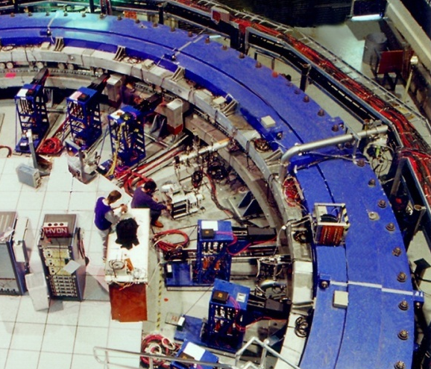
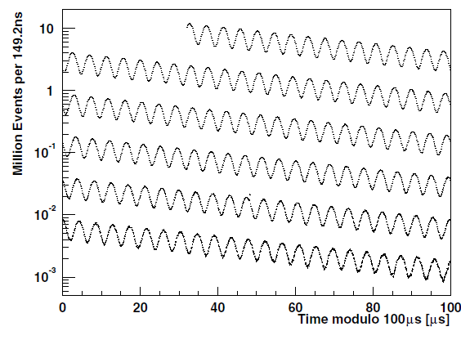
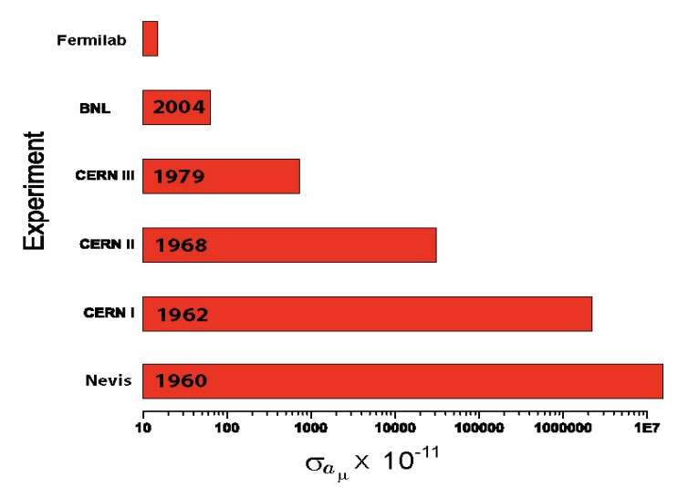
Intensity Frontier: Precision and Rare Processes
Precision measurement of muon anomalous magnetic moment, g-2
g-2 measurement history

Slide 20
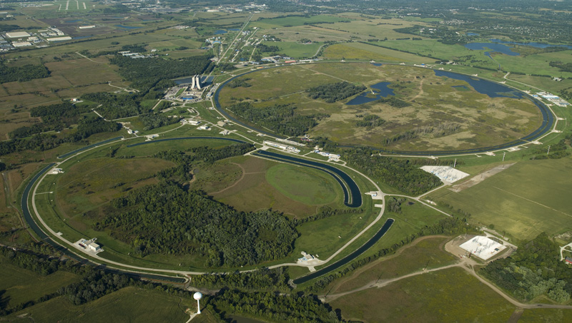
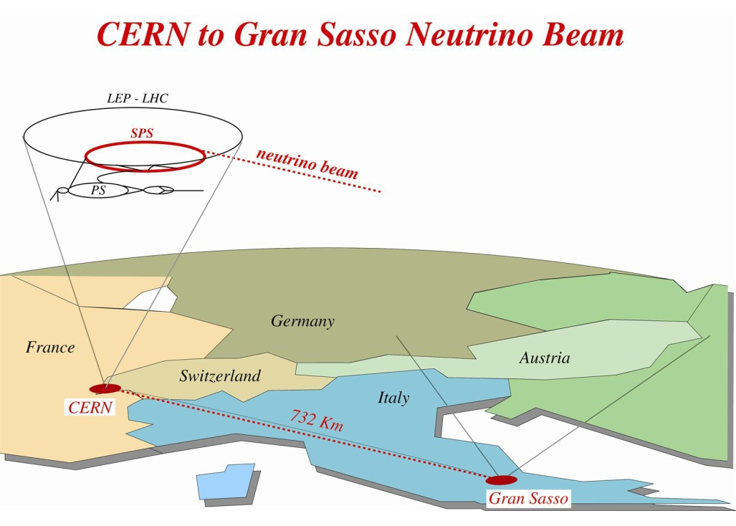
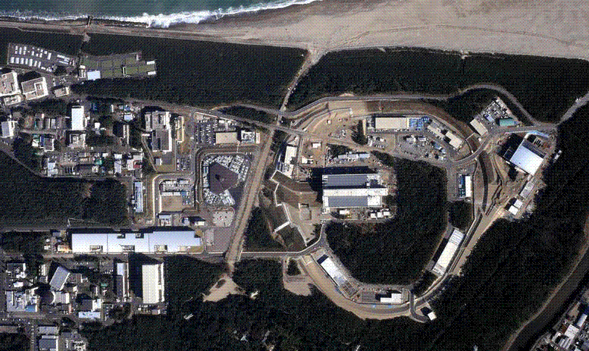
Intensity Frontier Accelerators
Operating facilities for long-baseline neutrino physics:
Fermilab
CERN
J-PARC

Slide 21
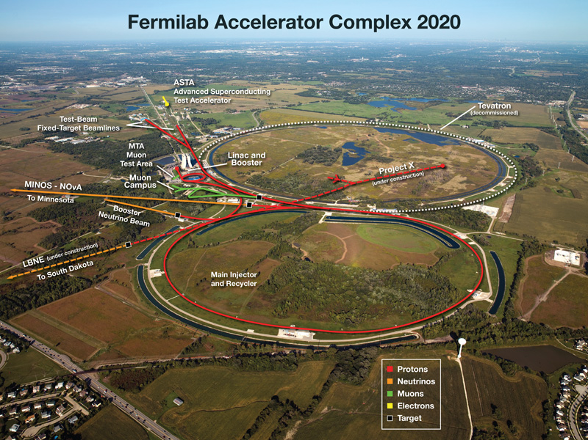
Project X Mission Elements
A neutrino beam for long baseline neutrino experiments
  2 MW at 60-120 GeV
High intensity, low energy protons for kaon, muon, and neutrino precision experiments
  3MW at 3 GeV
A path toward a muon source for possible future Neutrino Factory and/or a Muon Collider
  Requires ~4 MW at ~5-15 GeV
A facility to address missions beyond Particle Physics
Unique capability to provide multi-MW beams to multiple experiments simultaneously, with variable bunch formats.
Provides U.S. Intensity Frontier leadership for decades!

Slide 22
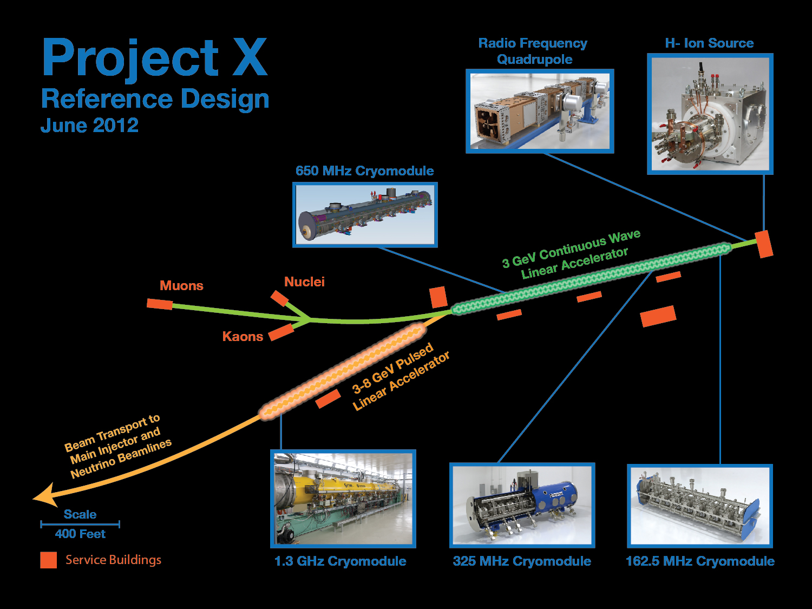
>2MW @120 GeV
3 MW @ 3 GeV
150 kW @ 8 GeV

Slide 23
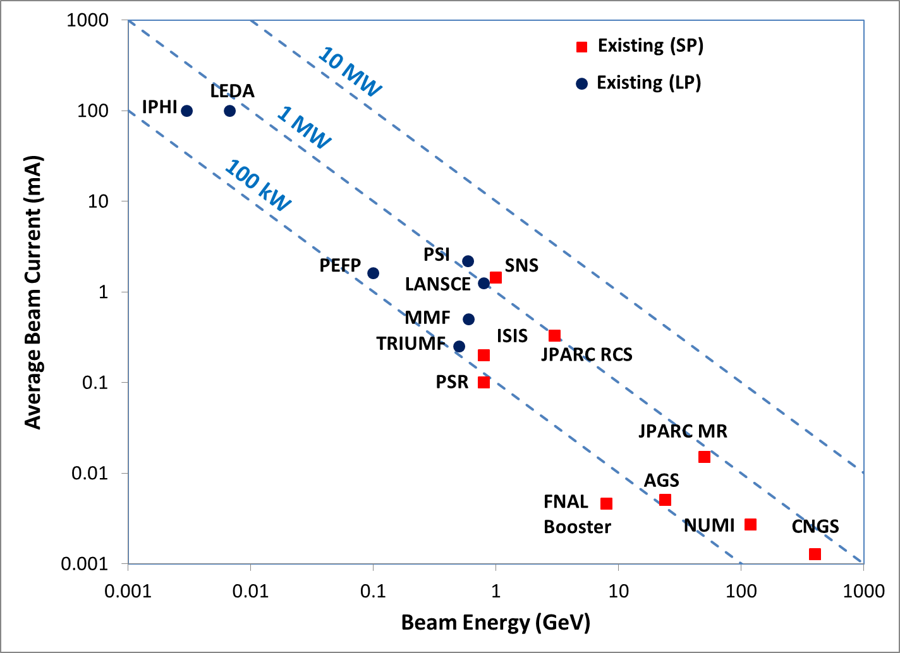
The Beam Power Landscape: Existing
Project-X

Slide 24
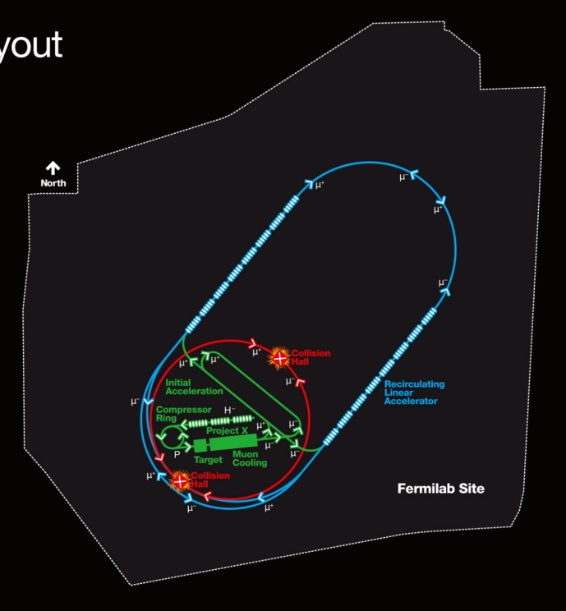
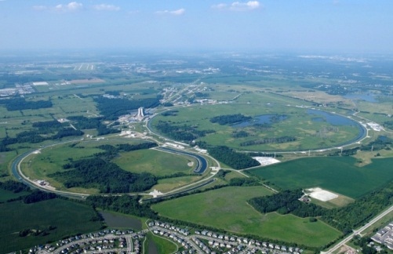

Intensity Frontier Facility Evolution at Fermilab
FNAL Complex
Project-X
μ SR
ν Factory
Muon Collider
Meanwhile, J-PARC intends to upgrade the linac and MR to provide higher beam power at 30 GeV
CERN is considering their long-term strategy

Slide 25

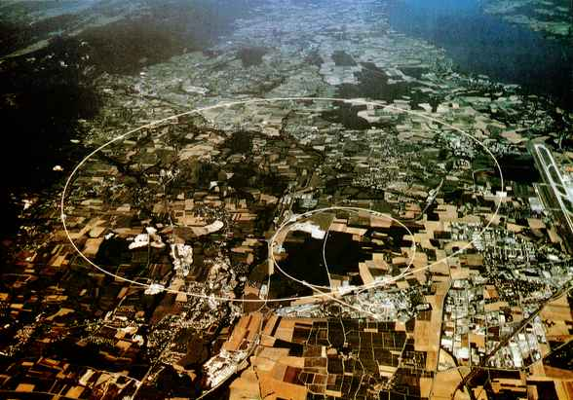
What About the Energy Frontier?
Circular Ring
Higgs Factories
Linac (ILC)
Muon Collider
Tevatron
pp: 2 TeV
_
LHC
pp: 7 TeV → 14 TeV
LHC Energy Upgrade (33TeV)
LHC results
Lepton Collider
ILC (0.5-1 TeV)
CLIC (~1-3 TeV)
Muon Collider (1.5-4 TeV)

Slide 26
What about the Energy Frontier?
Several ideas to get into the multi-TeV regime for lepton colliders
  Need AAC community to get there!
LHC upgrades will increase luminosity in the “near-term”, possible energy upgrades in the future if magnet technology can be developed
But beyond that, we face a great void in terms of direct searches at x10 LHC energies
We need to fill that void in a socially and financially realistic way
  Need AAC community to get there!

Slide 27

Challenges in Accelerator Physics and Technology for High Intensity Accelerators

Slide 28
Requirements and Challenges for High Power Hadron Accelerators
Minimizing beam loss is the over-riding design constraint
Typical beam loss requirements for a MW proton beam: < 1 Watt/m, < 1x10⁻⁴ total beam loss in a ring
Challenges
Producing high current high-quality beams (high brightness)
Accelerating high beam currents to high energy
  High-duty factor, high-power RF systems and structures, components
Transporting high power beams while maintaining beam loss at a level where routine maintenance is possible
  Acceleration of beams from keVs to GeVs preserving emittance and minimizing growth in large-amplitude particles (“beam halo”)
Target systems capable of handling extreme power densities and extreme radiation environments
A related challenge is producing intense, high-quality beams of secondary particles (muons, kaons, …)

Slide 29
Timeline of Key Developments in High Intensity
2006: high-power test liquid metal target
2005: SC proton linac
1984: ISIS Rapid cycling proton synchrotron
1995: Massively parallel computation
1981: phase-space painting concept
1973: H- source invented
1970: RFQ Invented
1969: ECR source developed
1966: Charge-exchange injection
1964: Side-coupled structure concept
1958: First Isochronous proton cyclotron
1950: MTA Program
1947: 32 MeV Alvarez Drift-tube linac

Slide 30
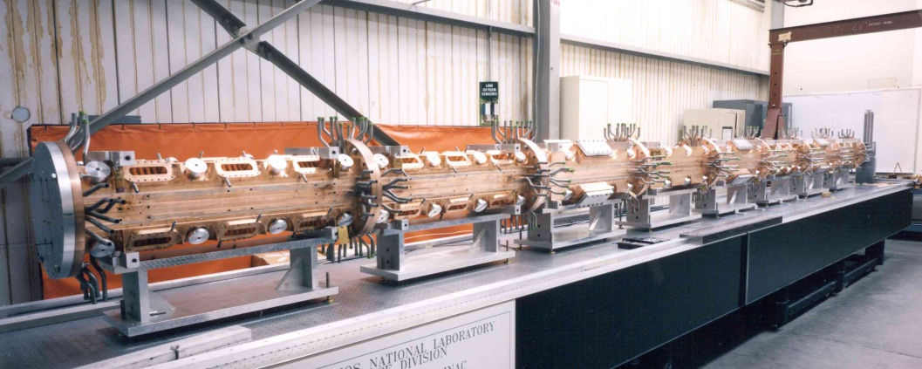
Creating a Beam: Sources and Injectors
Proton sources developed at CEA/Saclay and LANL have achieved > 100 mA CW current
Radio-frequency quadrupoles are the injector technology of choice
State of the art performance: 100 mA CW demonstrated at LANL/LEDA with 6.7 MeV output energy
Alternative technology must compete with very capable conventional technology
LEDA Source and RFQ

Slide 31
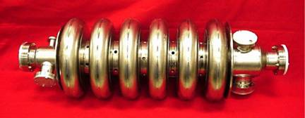
Acceleration in Intensity Frontier Accelerators
It’s all about power transfer!
I_{peak} = 50 mA
I_{ave} = 3 mA
T₀
T₀ + 15 MeV
750 kW Peak RF Power
45 kW Ave. RF Power

Slide 32
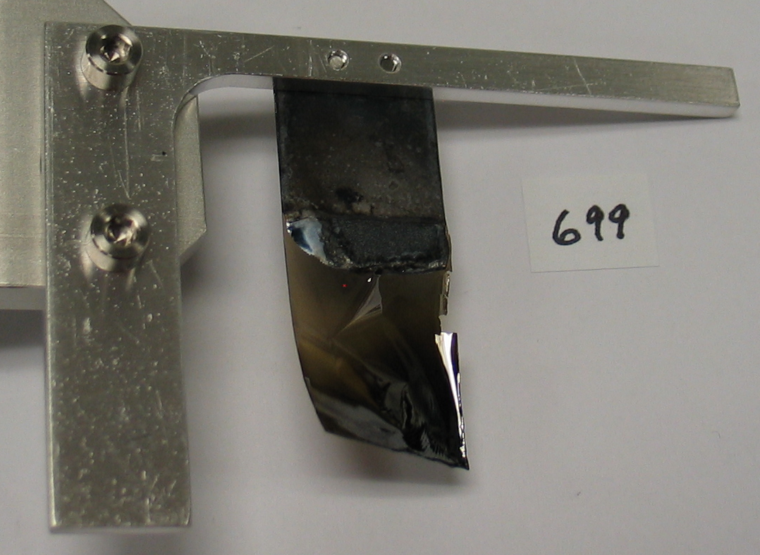
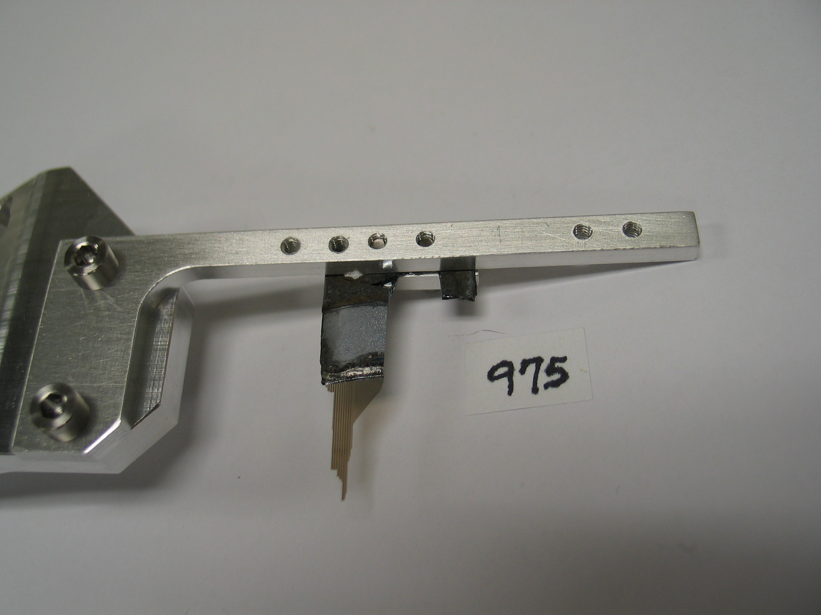

Charge-Exchange Injection and Stripping
The conventional approach to accumulating high proton intensities in a ring is to use multi-turn charge-exchange injection of H- beams
But it is very challenging:
Challenge for AAC community: achieving highly efficient H- stripping for CW beams
Novel Laser Stripping idea from Danilov et. al. has been demonstrated
Scaling to realistic parameters is needed
Laser Beam
High-field Dipole Magnet
High-field Dipole Magnet
α
H⁻
H⁰
H^{0*}
proton
Step 1: Lorentz Stripping
Step 2: Laser Excitation
Step 3: Lorentz Stripping
H⁻ → H⁰ + e⁻
H⁰ (n=1) + γ → H^{0*} (n=3)
H^{0*} → p + e⁻

Slide 33
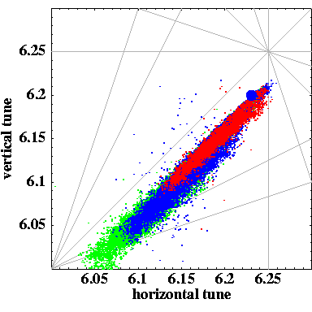
High Intensity Beam Dynamics
Typical design of a synchrotron, accumulator or compressor is limited in intensity due to
space-charge at injection
instabilities
A number of interesting ideas to overcome limitations require further development
Creating self-consistent beam distributions (i.e. linear space-charge force) - Danilov
Generating large Landau-damping of coherent instabilities via non-linear (but stable) betatron motion: IOTA and previous work – Danilov and Nagaitsev
Experimental insight is very important (UMER Ring)

Slide 34
Extracting High Power Beams
Slow spills of high intensity beams are needed in particle physics, but beam loss limits intensity
Challenge for AAC community: are there novel ways to cleanly achieve slow spills of high intensity beams?
Resonant extraction, can it be extended to higher orders?
Can crystals be used for high-power proton extraction?
Can electron beams be used to extract protons?
New ideas are needed!!! Lasers??? High brightness electron beams???

Slide 35
Characterization and Understanding of High Intensity Beams and Underlying Dynamics
Challenge to AAC community: instrumentation for precise halo (and emittance) measurement and connection to simulation in a reliable way
Matched Beam
Mismatched Beam
Horizontal profile measured at end of channel compared with profile of beam simulation.
Horizontal profile measured at end of channel compared with profile of beam simulation.
Simulations used particle distributions generated from beam evolution through LEBT and RFQ.

Slide 36

How Does an Intensity Frontier Facility Connect to the Energy Frontier?

Slide 37
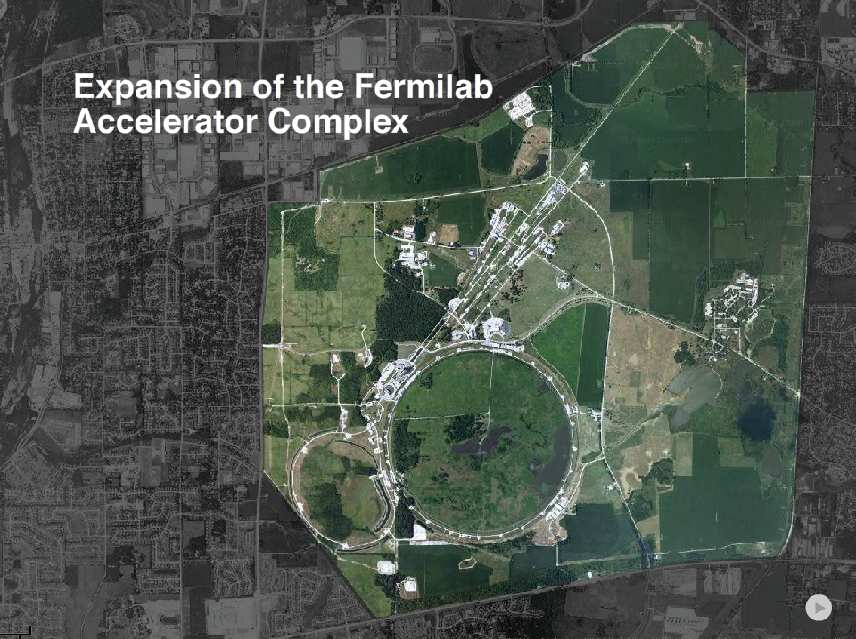
37
Sample Communication Talk
24
Notes:
37

Slide 38
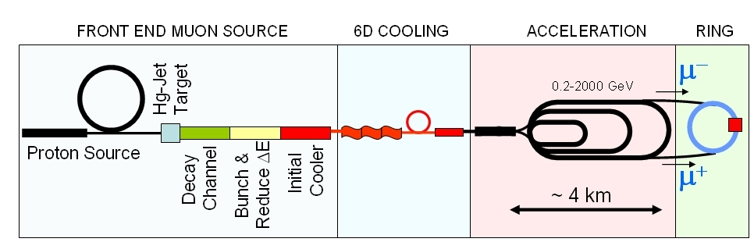
Muon Collider Schematic
√s = 3 TeV
Circumference = 4.5km
L = 3×10³⁴ cm⁻²s⁻¹ μ/bunch = 2x10¹²
δp/p = 0.1%
e_{⊥N} = 25 μm, e_{//N}=70 mm
β* = 5mm
Rep Rate = 12Hz
10²¹ muons per year that fit within the acceptance of an accelerator:
e_{⊥N}=6000 μm
e_{//N}=25 mm
Proton source: Example: upgraded PROJECT X
(4 MW, 2±1 ns long bunches)

Slide 39
A Muon Collider Has Many Challenging Ingredients
Proton Source
Multi-MW, Multi-GeV beam
Accumulation of long-beam pulse in accumulator rotated in compressor ring
nsec bunch length on target
Target System
Multi-MW with very high peak power deposition
~250kJ per beam pulse
Liquid metal system
Integrated within strong solenoidal (20T) fields

Slide 40
A Muon Collider Has Many Challenging Ingredients
Bunching and Phase Rotation
Bunch train formed with 12 bunches
Phase rotation to transform large ΔE-small Δt to small ΔE-large Δt
Requires high gradient NC cavities operating in a high-magnetic-field channel
Cooling channel(s)
Must reduce 6D phase space by a factor of O(10⁶)
Requires superimposed RF and magnetic fields
6-d cooling channels require novel configurations
Final cooling requires very high solenoidal fields beyond present state-of-the-art
Space-charge effects are important
40

Slide 41
A Muon Collider Has Many Challenging Ingredients
Acceleration
Multiple acceleration stages required (using recirculating linacs, rapid cycling synchrotrons)
Design is challenged by large longitudinal emittance, co-acceleration of μ+, μ-, need for good transmission
41

Slide 42
A Muon Collider Has Many Challenging Ingredients
Muon Collider Ring
Must bring ~10MW muon power into collision
Designed to operate at beam-beam limit
Challenging lattice
  Large momentum acceptance
  Small β* and σ_{l}
  Low α_{c} and large chromatic effects
Substantial decay electron flux
  Detector backgrounds and Machine-Detector Interface
  Decay heat-load (~2MW electron load)
Neutrino radiation may limit highest energies
42

Slide 43
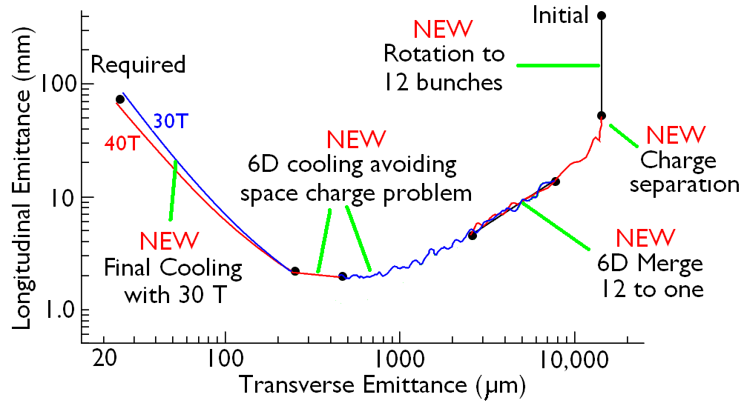
Ionization Cooling Concepts
Development of a cooling channel design to reduce the 6D phase space by a factor of O(10⁶) → luminosity O(10³⁴) cm⁻² s⁻¹
Some components beyond state-of-art:
High gradient RF cavities operating in few Tesla fields & Very high field HTS solenoids
Challenging solenoids in the last stages of cooling:
Original design needed 50 T solenoids. Recent improvements suggest 30 T sufficient.
R. Palmer
HTS
HTS
43

Slide 44
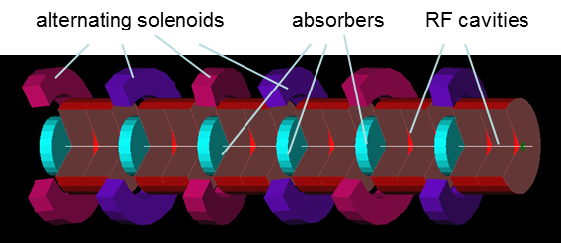
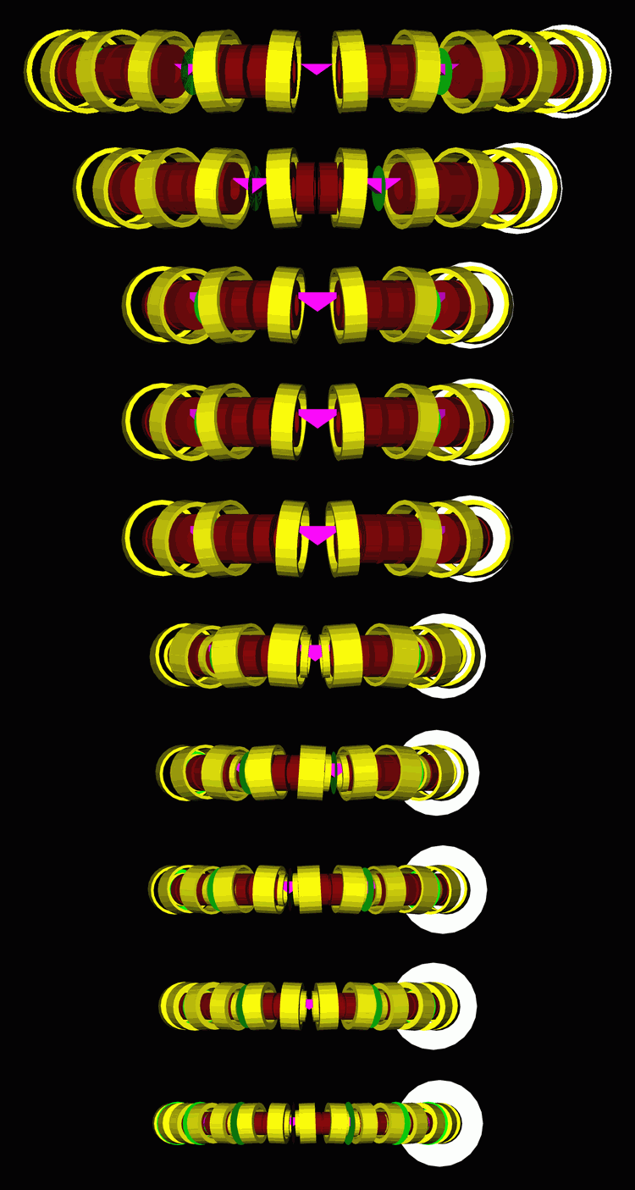
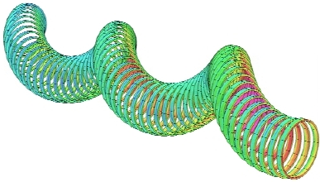
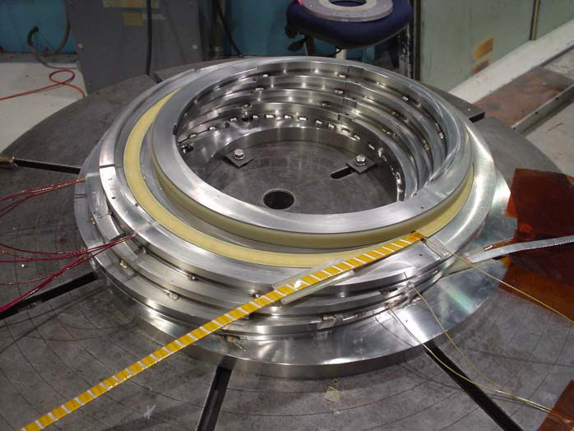
Ionization Cooling Concepts
Helical FOFO Snake: Tilted solenoids, RF, LH₂ absorbers
Tapered Guggenheim: Tilted, displaced solenoids, RF, LH₂ absorbers
Helical cooling channel: coils arranged around helical trajectory, RF, H₂ gas filled

Slide 45

Other Forces are at Work!
There is growing recognition that, in addition to their role in Discovery Science, accelerators are vital to industry, medicine, national security, and have potential in energy and environment
With that comes an increasing emphasis on applied accelerator technology
This field has real potential to make an impact
Seek out application of your developments and technology

Slide 46
Summary
The Advanced Concepts field has great successes to point to
  Work hard to look for applications now!
  It is important to “cement” some of these successes
The field is charting a course toward the Intensity Frontier
  We need your help and creative thinking to help solve vexing problems
LHC results will point the way on the Energy Frontier. This field is highly relevant to future facilities:
  Alternatives beyond “conventional factories” for Higgs?
  High-energy lepton colliders
We face a void at energies well beyond LHC
  We need you to help fill this void in a socially and financially realistic way!

Slide 47

We Want You!

Slide 48
Approaches to High Beam Power
Long pulse (~msec or cw) from a linear accelerator
LANSCE, ESS
Project-X
FRIB, IFMIF
SNS
PSR/LANL
Driver for Muon Coll.
Accumulation of a long-pulse in a fixed energy ring
Accumulation of a low-energy long-pulse in a synchrotron, and acceleration to high energy
HEP Inject.
ISIS/RAL
J-PARC
Continuous beam from a Cyclotron/FFAG
PSI

Slide 49
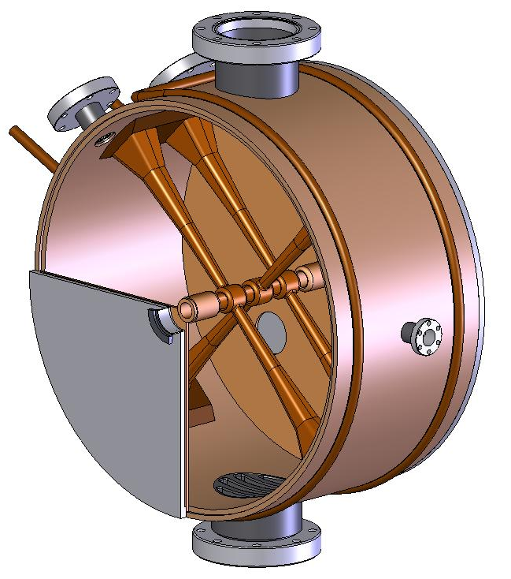
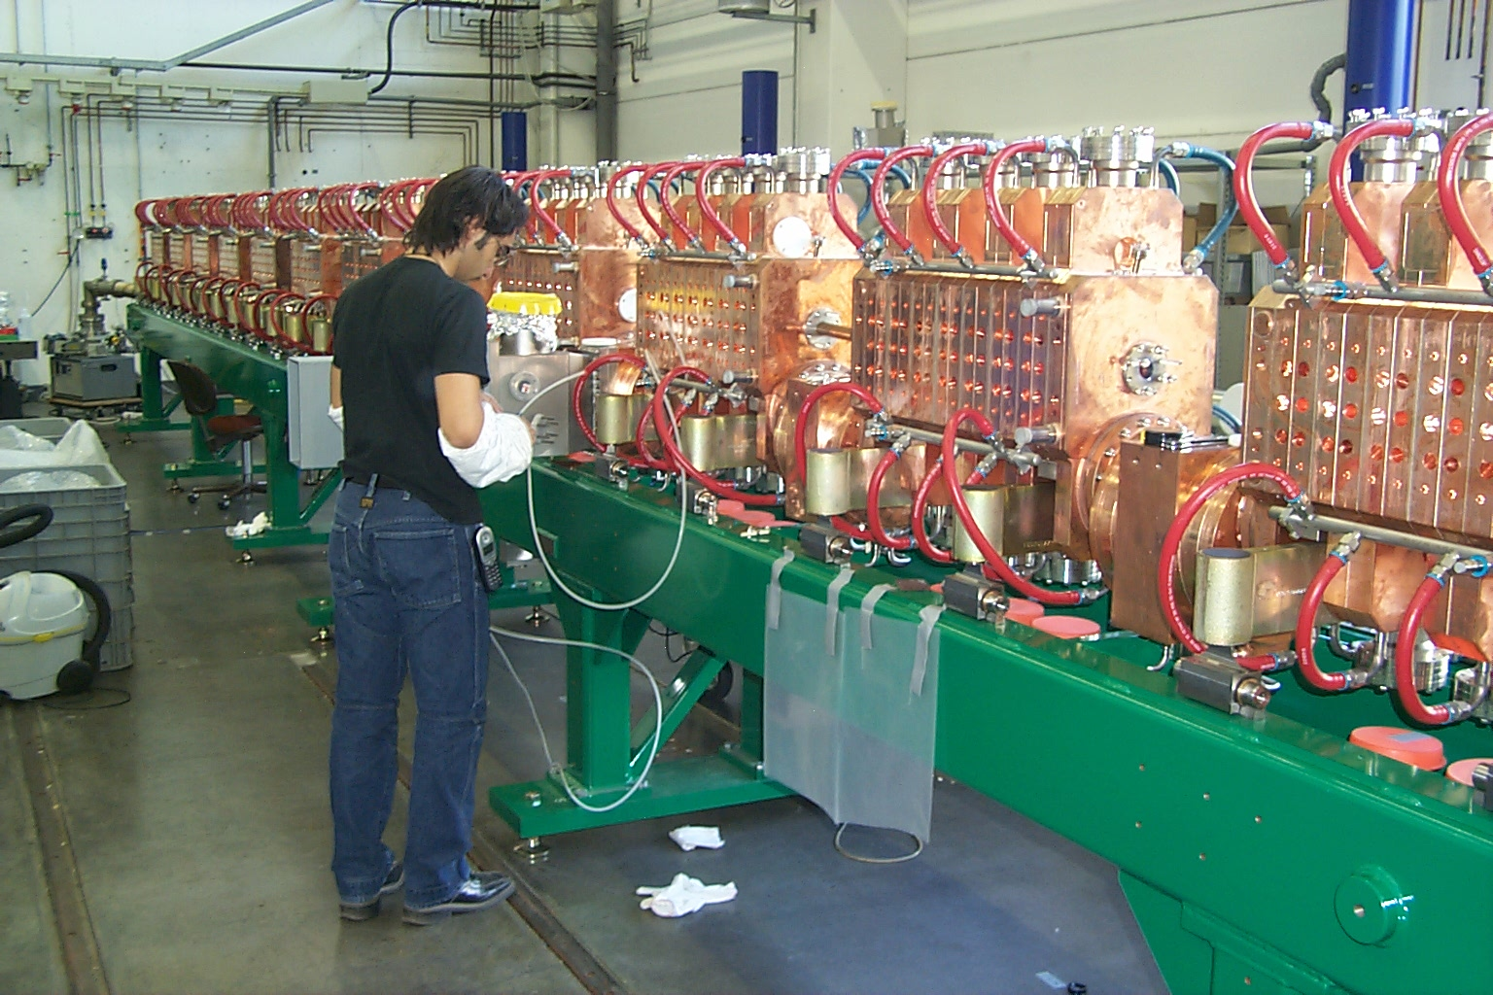
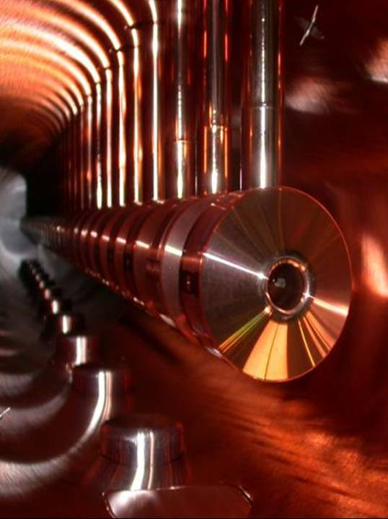
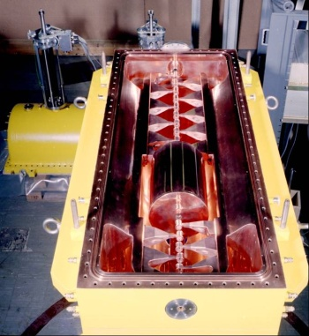
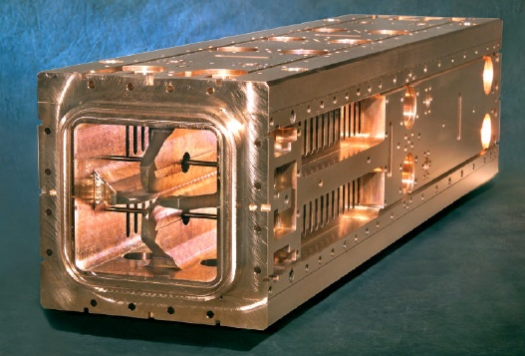

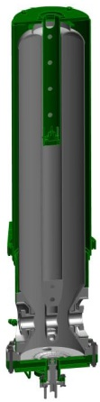
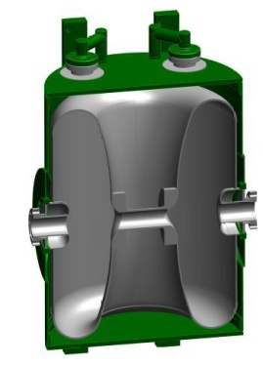



A Zoo of RF Structures for β < 1 Acceleration
Normal Conducting Structures
β=0
β=1
0.05
0.1
0.25
0.5
0.8
Superconducting Structures

Slide 50

Linac Architecture Design Choices
Choice of RF structure
Choice of RF frequency (structure, available RF power sources)
What gradient can be reliably achieved in practice?
Choice of NC/SC transition energy (trend pushes lower)
Lattice type: solenoid or quadrupole focusing?
Warm to cold transitions? Warm or cold instrumentation? Cryogenic segmentation: parallel cryogenic feed from a transfer line, or interconnected cryomodules?
Cryogenic temperature: 2K, 4K?
Extract Higher-Order-Mode power or not?

Slide 51

State of the Art in Halo/Emittance Growth Measurement and Simulation
LEDA measurements and IMPACT code comparison: J. Qiang et. al., PRST-AB 5 (124201) 2002.
52 quadrupole focusing channel with intentionally mismatched, low-energy, high-intensity beam
Plot shows vertical beam profile data (points) compared to simulation (line) at 9 locations
Conclusion: Knowledge of input distribution is incomplete; inadequate to achieve quantitative agreement for mismatched beams
Data
Simulation

Slide 52


Laser-Stripping Injection Proof-of-Principle Experiment
Laser Beam
We have developed a laser-based stripping technique [Danilov et. al., PRST-AB 6:053501, 2003]
The key step is efficiently populating the upper state in hydrogen by interaction with a diverging laser-beam
High-field Dipole Magnet
High-field Dipole Magnet
α
H⁻
H⁰
H^{0*}
proton
Step 1: Lorentz Stripping
Step 2: Laser Excitation
Step 3: Lorentz Stripping
H⁻ → H⁰ + e⁻
H⁰ (n=1) + γ → H^{0*} (n=3)
H^{0*} → p + e⁻
We demonstrated > 90% H- to proton stripping efficiency over the duration of a short laser-pulse [Danilov et. al., PRST-AB 10:053501, 2007]
We are preparing a follow-on experiment to demonstrate stripping of 10 μs pulse
H- to protons

Slide 53

Technical Challenges: Target Systems
Many high-power applications require liquid metal target systems
  beam power densities (MW/liter) are beyond the level at which solid materials can survive (or heat removal can be accomplished)
Liquid lithium
  Fragmentation targets for radioactive ion beam facilities
Pb-Bi Eutectic (melting point ~125 °C)
  Spallation sources for neutron scattering and accelerator-driven systems
  MegaPIE experiment at PSI tested Pb-Bi Eutectic as a spallation target material [W. Wagner et. al., J. Nuc. Mat. 377 (2008) 12.
  Proved the concept from both a technical and safety perspective
MEGAPIE at PSI: Pb-Bi Eutectic

Slide 54

Grand Challenges in Accelerator Science
Extend the energy reach of collider technology to explore fundamental phenomena at the Terascale and beyond
  Extend the reach of magnet technology
  Develop concepts and technologies for next-generation lepton colliders (ILC, CLIC, MC)
Extend the beam power and intensity reach of hadron accelerator technology to enable next-generation capabilities in fundamental physical sciences and applications in energy
  Needs: Advanced simulation, high-intensity sources, advanced beam instrumentation, RF structures for efficient acceleration, reliability improvements, high power target systems
  High-power accelerators on the horizon: Project-X, ESS, MYRRHA, …

Slide 55

Grand Challenges in Accelerator Science
Develop concepts and technologies to extend the brightness, brilliance and coherence of photon sources to meet the challenges of 21st century materials science
Many types of accelerators are in this category: FELs, storage-ring light sources, energy-recovery linacs, compton sources, …
  High brightness electron sources
  Advanced computation capabilities
  Techniques for seeding FELs
This technology promises broad applicability particularly as such sources become more compact
Courtesy B. McNeil, M. Borland,

Slide 56


Grand Challenges in Accelerator Science
Develop scalable next-generation acceleration methods with gradients > 1GeV/meter
  Very exciting field exploring concepts for accelerating particles in plasmas and dielectrics
  Large scale facilities exist for testing beam-driven and laser-driven concepts
Plasma-based accelerators produce tremendous fields by separating charges in a plasma, excited by a drive beam or laser pulse
Some electrons double energy from 42 to 80+ GeV in 84 cm

Slide 57


Grand Challenges in Accelerator Science
Simulation of laser-plasma interaction and electron acceleration
Courtesy John Cary, Peter Messmer, the VORPAL Team ,Tech-X Corp.

Slide 58


Grand Challenges in Accelerator Science
Extend the capability and understanding of performance limits of RF accelerating structures and technology
  Ultimate gradient limits of NC (with adequate breakdown rate) and SC (with adequate Q) RF structures
Develop tools and technologies for the manipulation of particle beam phase-space and the exploration of limitations to beam emittance
  Beam cooling, emittance manipulation, limitations to beam emittance
Develop compact sources of electrons, photons, neutrons, protons and ions
  Explore capabilities and limitations in conventional and emerging technologies to engineer cost-effective next-generation compact sources

Slide 59








High Power Proton Accelerators: Some History
1972: LANSCE
1974: PSI
1985: ISIS
1999:Main Injector
2006: SNS
1950s: Materials Test Accelerator

Slide 60

Project X Reference Design
>2MW @120 GeV
3 MW @ 3 GeV
150 kW @ 8 GeV
Unique capability to provide multi-MW beams to multiple experiments simultaneously, with variable bunch formats.
  Design concept/configuration stable for more than a year
Provides U.S. Intensity Frontier leadership for decades!

Slide 61

The Beam Power Landscape: Planned
Project-X

Slide 62

Origin of Mass: Higgs Boson
m_{Higgs} prediction from m_{W}, m_{top} meas.s
m_{Higgs} < 145 GeV/c² at 95%CL
Results still coming out from Tevatron
top
bottom
Higgs
W W

